Slide 1
Supply Chain Dashboard using Tableau
Created by Rounak Saha

Slide 2
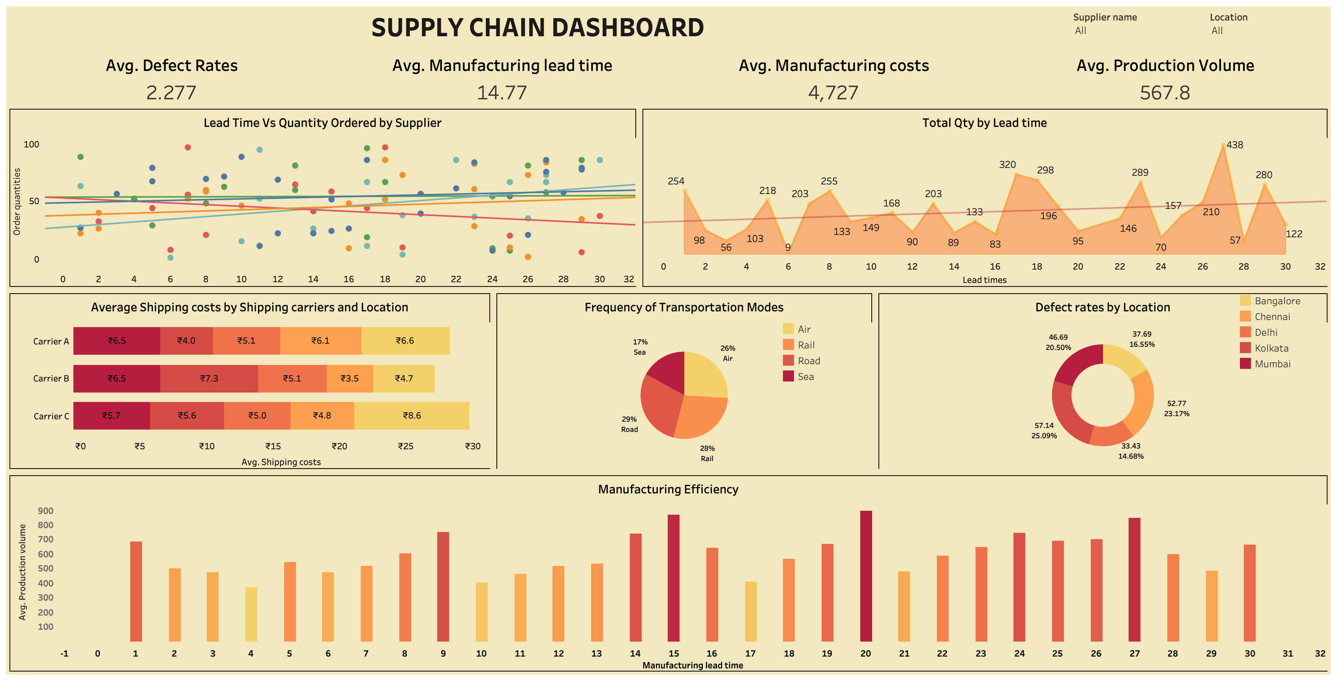

Slide 3
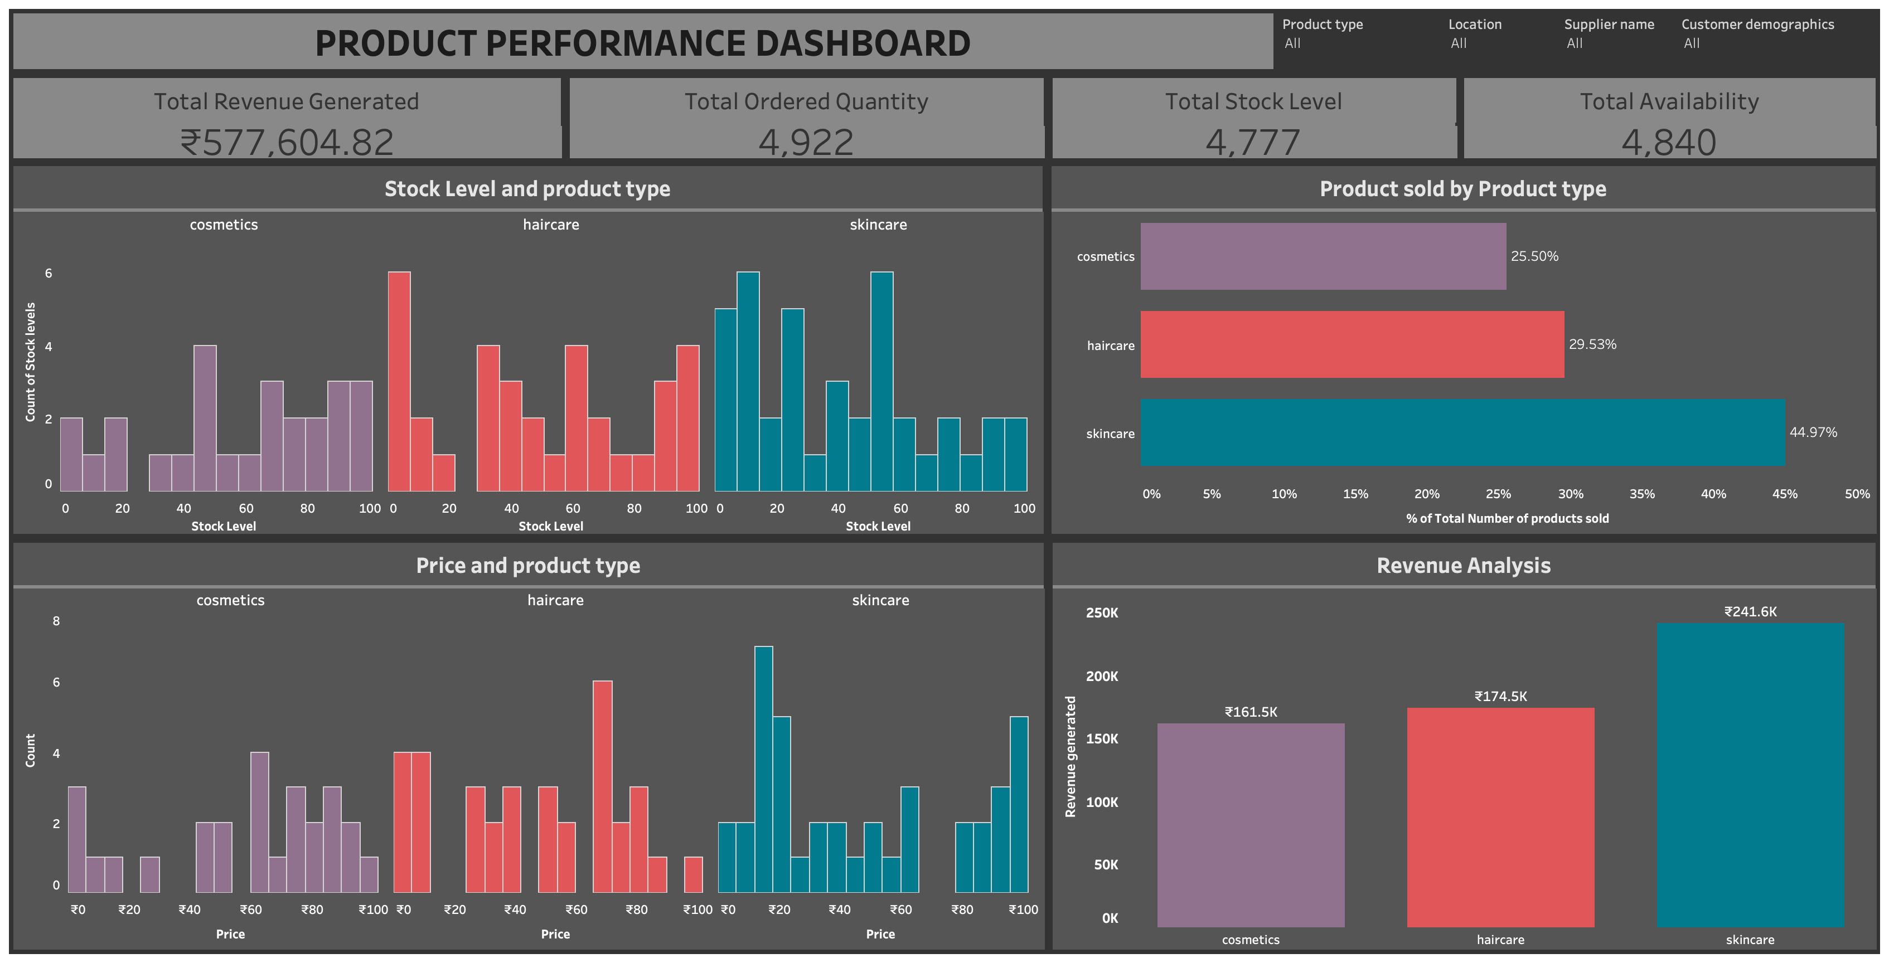

Slide 4
